Slide 1
Developing Your First Android Project
Android Mobile Development

Slide 2
Introduction
Before we start building Android app, we should have these tools in our machine
IDE (Integrated Development Environment)
Android SDK (Software Development Kit)
JDK (Java Developer Kit)

Slide 3
IDE
IDE is an environment that helps programmer coding and designing the application
The environment itself has a programming tools to make programming easier

Slide 4
IDE
The tools such as :
Syntax Highlighting
Error Indication
Folder Structuring
Logging System
Etc

Slide 5

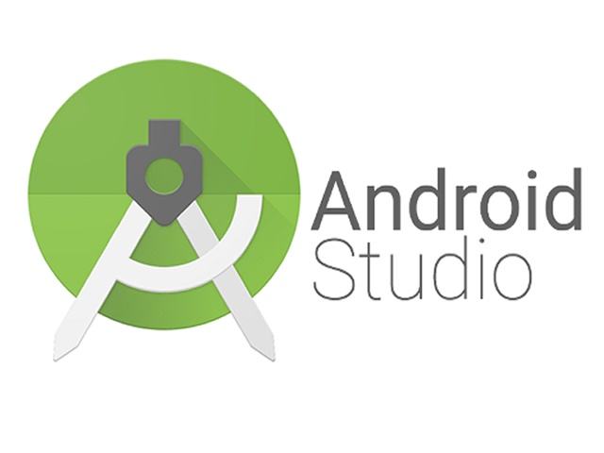
IDE

Slide 6
SDK
The Android SDK (software development kit) is a set of development tools used to develop applications for Android platform.
The Android SDK includes the following:
Libraries
Debugger
Emulator
Documentation
Sample Source Code

Slide 7



Android Studio & Android SDK
Android SDK helps Android Studio in the background
For example Android SDK converts the code you write in Android Studio to APK and run it on emulator

Slide 8
JDK
JDK is a software development environment used for developing Java applications and applets.
It includes the Java Runtime Environment (JRE), an interpreter/loader (java), a compiler (javac), an archiver (jar), a documentation generator (javadoc) and other tools needed in Java development.
When you build the project all .java files get converted to .class. For which you need JDK.
Now the dx tool of adk converts all .class files to classes.dex file. And this classes.dex file is executed on dalvik virtual machine.

Slide 9
Download The Tools
Download JDK from : http://www.oracle.com/technetwork/java/javase/downloads/jdk8-downloads-2133151.html
Android Studio (SDK included) : https://developer.android.com/studio/index.html

